Slide 1
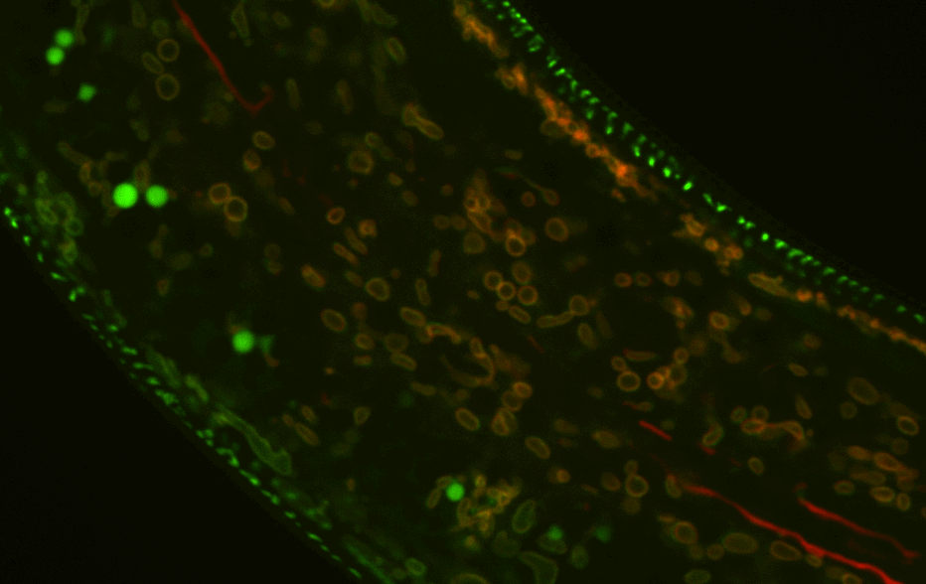


C. elegans as a model to probe the cell biology and genetics of aging
Tyler Butsch, Ph.D.

Slide 2
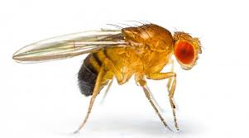

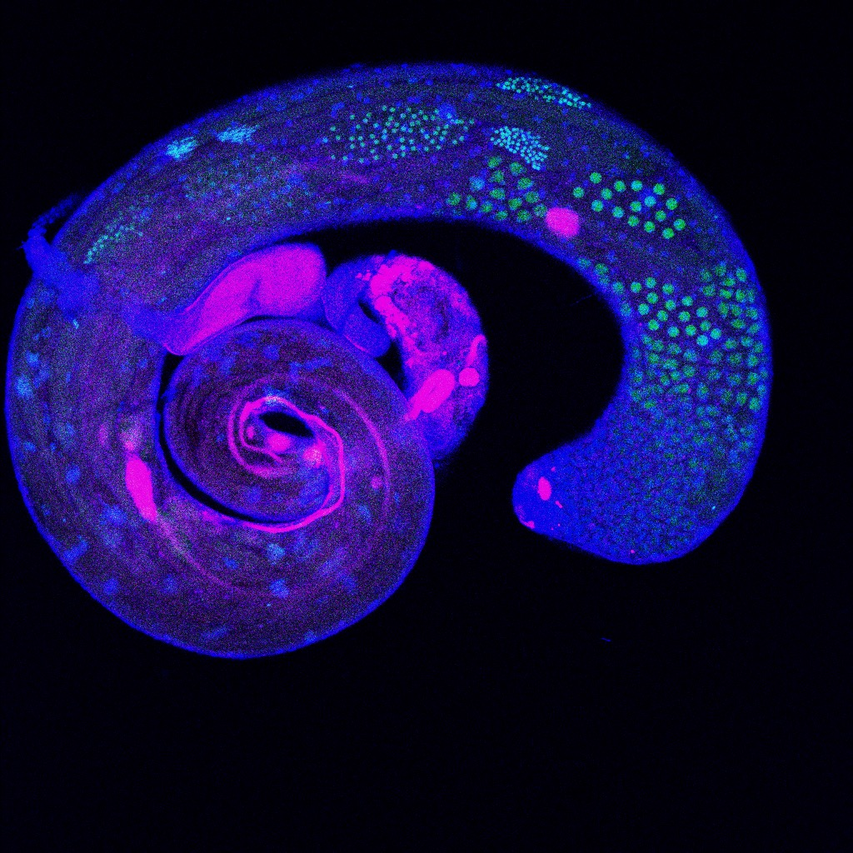

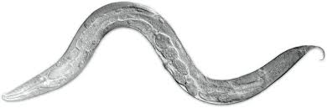
My academic research journey
Bachelor’s degree 2012-2016
Biology
Drosophila melanogaster
Master’s degree 2016-2018
Genetics of reproductive aging
C. elegans
Doctoral degree 2018-2023
Cell biology and genetics of sperm development and aging
Postdoctoral fellow 2023-present
Metabolism of aging
Aging has always fascinated me

Slide 3
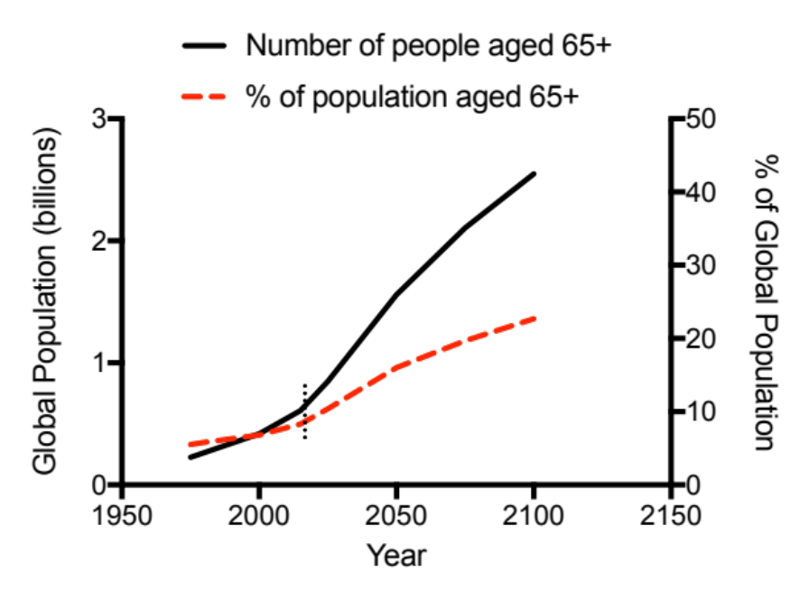
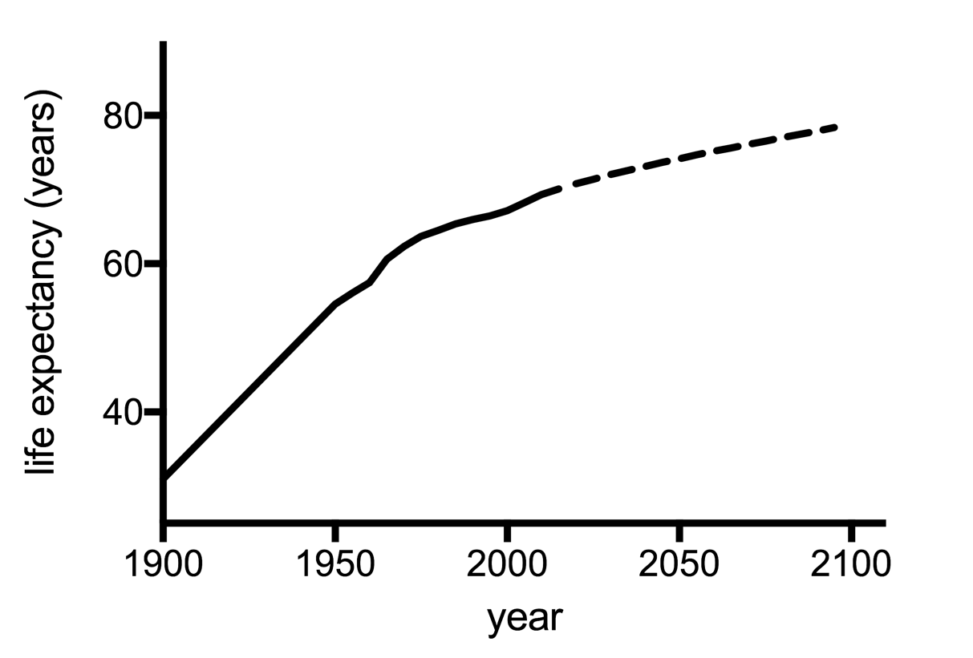





Public Health Success: an aging global population
infectious disease
immunization
childhood mortality
Burkewitz et al., Experientia Supplementum, 2016; UN and WHO data.

Slide 4
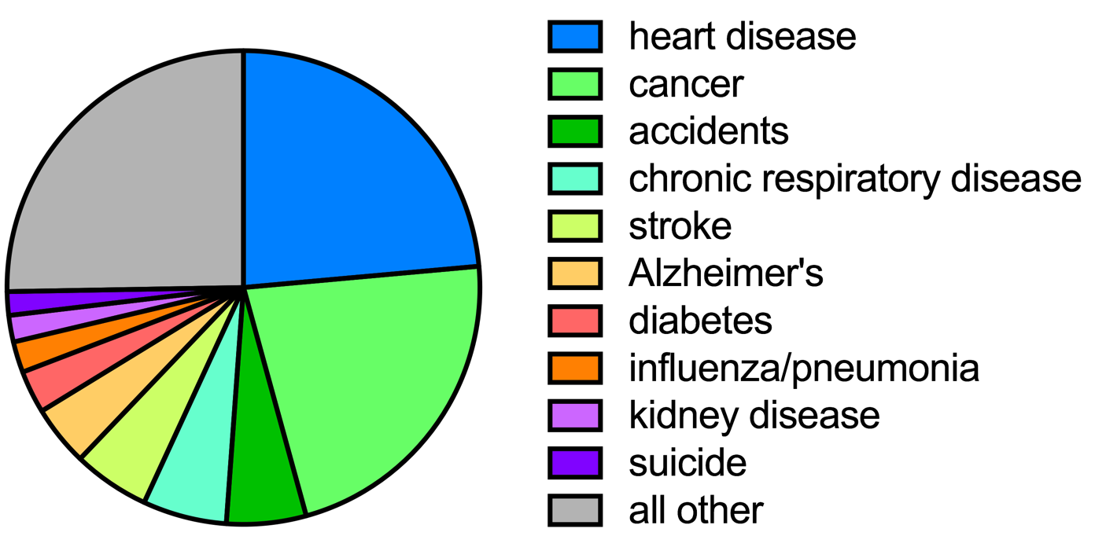
Age carries a new set of problems
Top 10 Causes of Mortality
Data from CDC

Slide 5
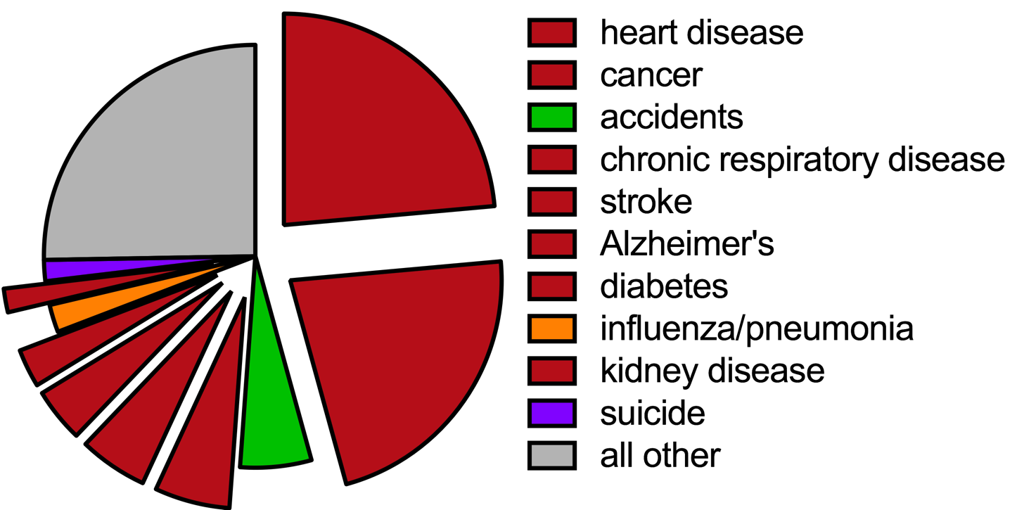
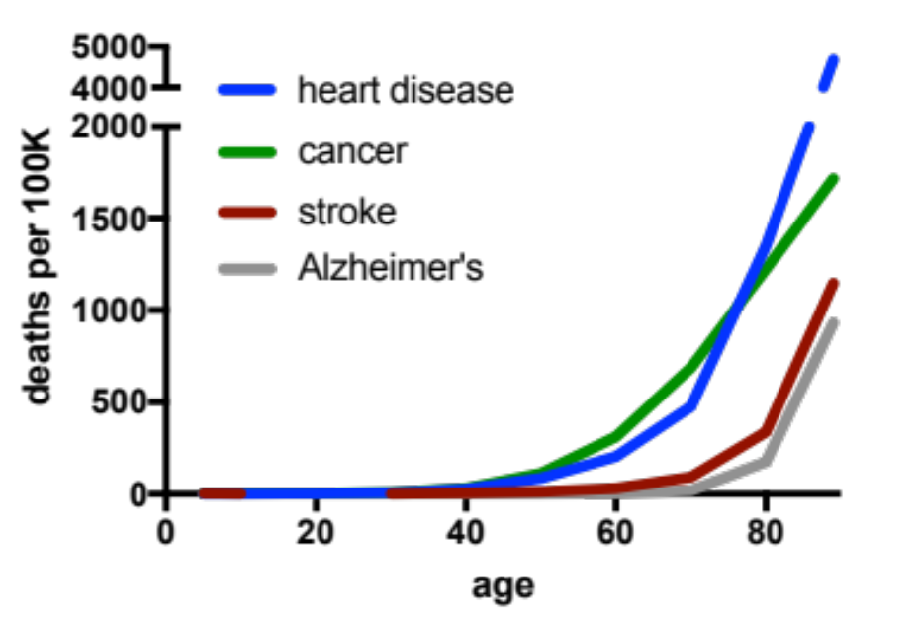
Age carries a new set of problems
Top 10 Causes of Mortality
Data from CDC

Slide 6



Can we generally treat age-related diseases by slowing the rate of aging?
Aging-related changes
diabetes
cancer
heart disease
Alzheimer’s
Intervention?

Slide 7



Can we generally treat age-related diseases by slowing the rate of aging?
Aging-related changes
diabetes
cancer
heart disease
Alzheimer’s
Intervention?

Slide 8
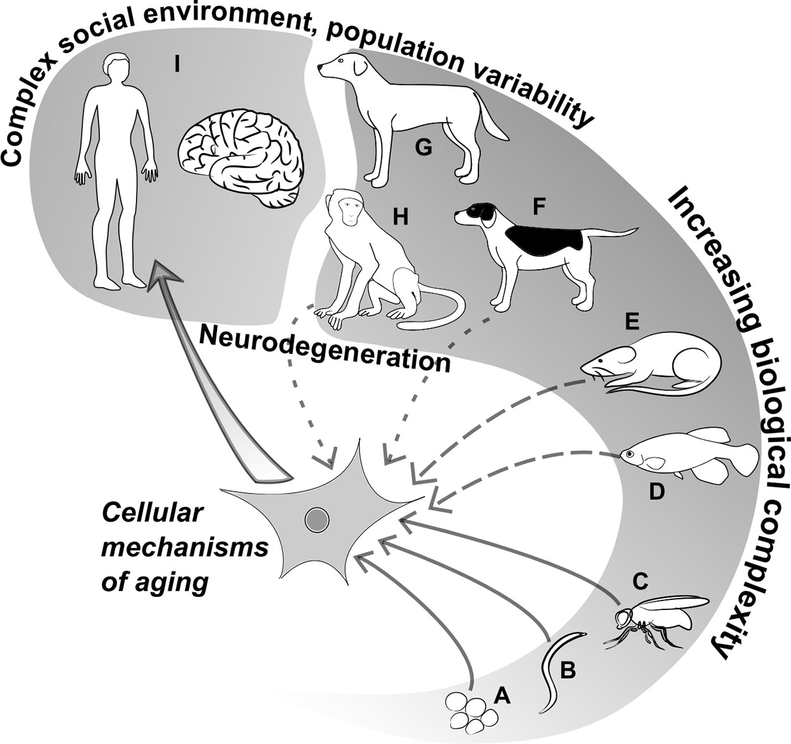
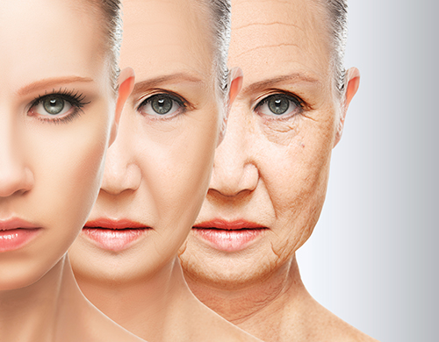
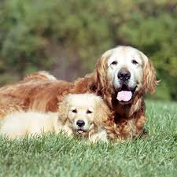
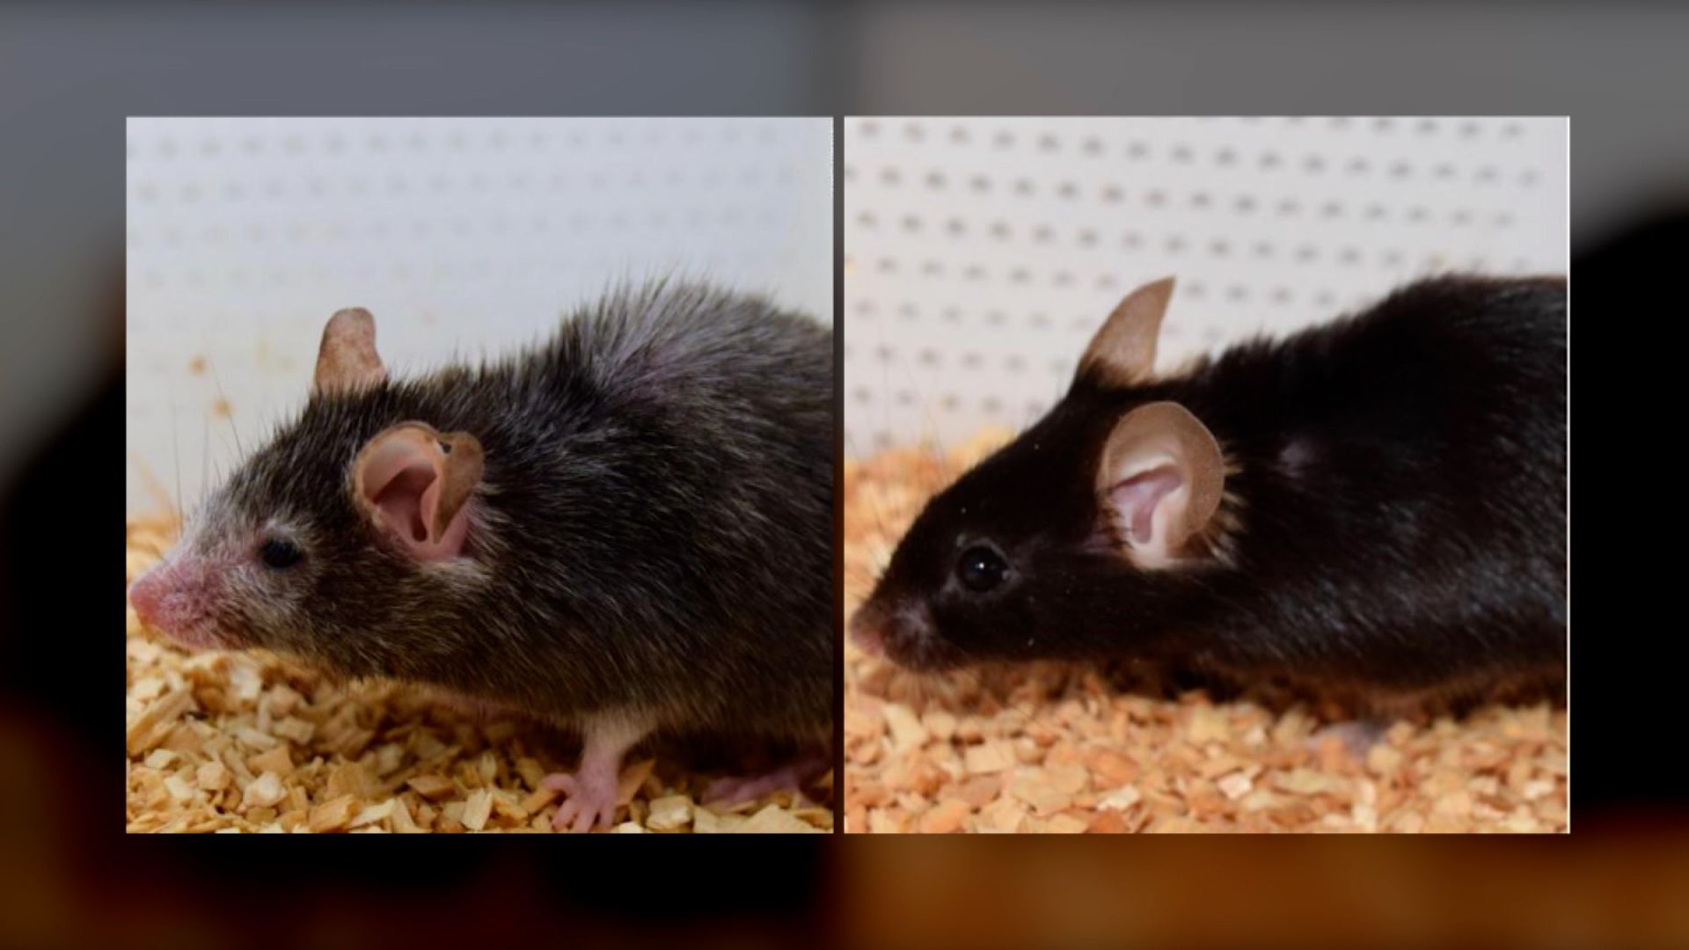
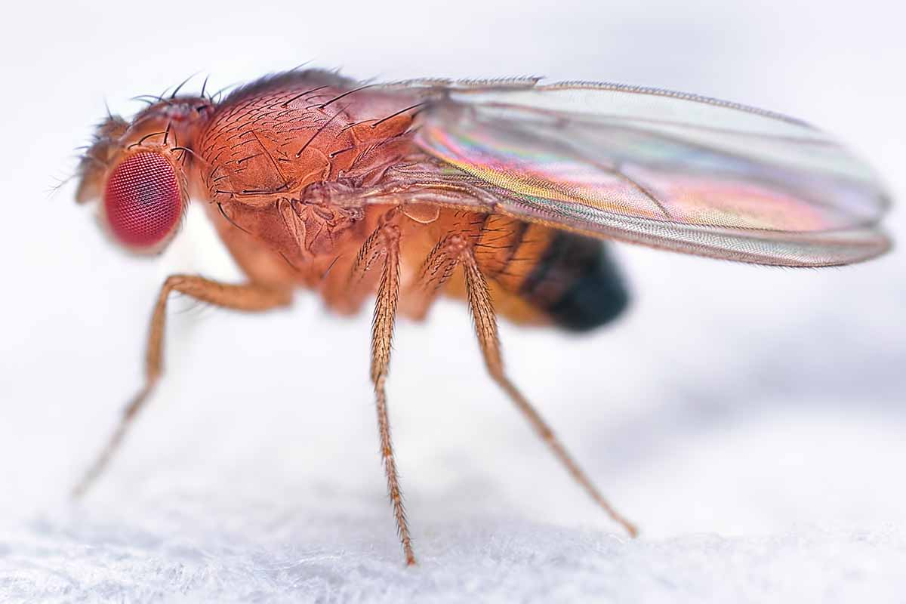
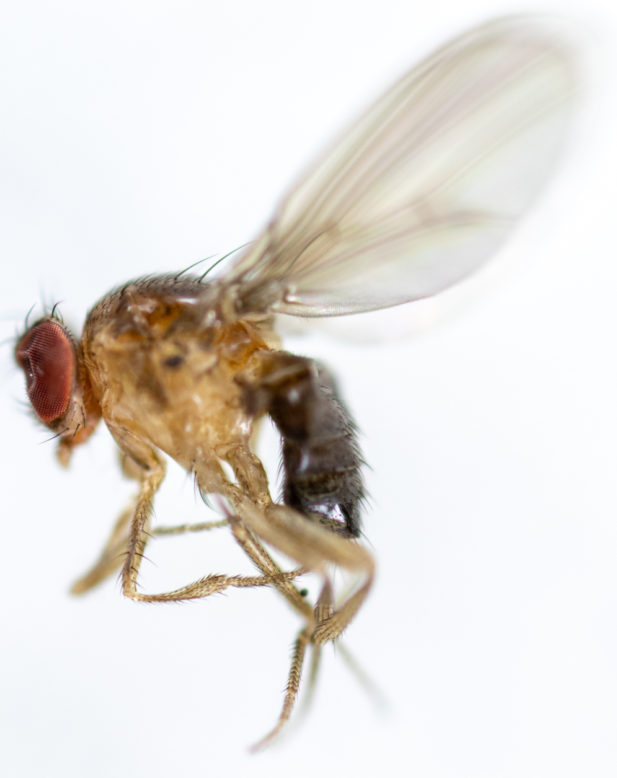
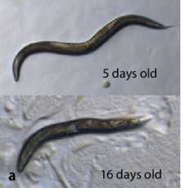
Aging affects nearly all animal species
Human
Dog
Gen Eng Biotech
Mouse
Newsweek
Drosophila melanogaster
CNN
C. elegans
Sandor and Kubinyi. 2019. Front Aging

Slide 9
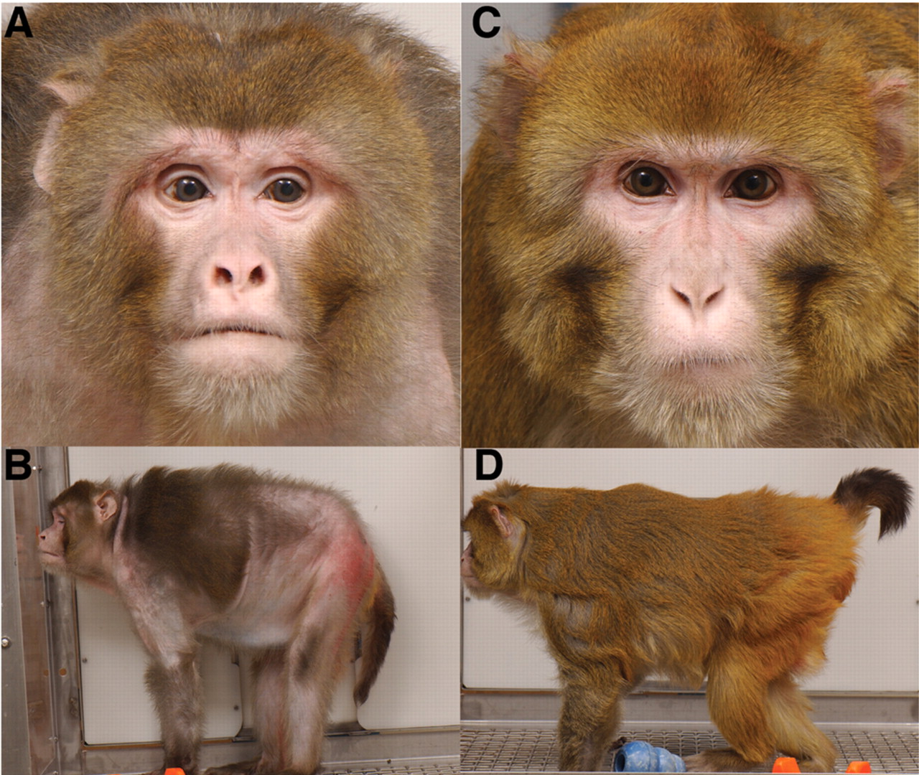
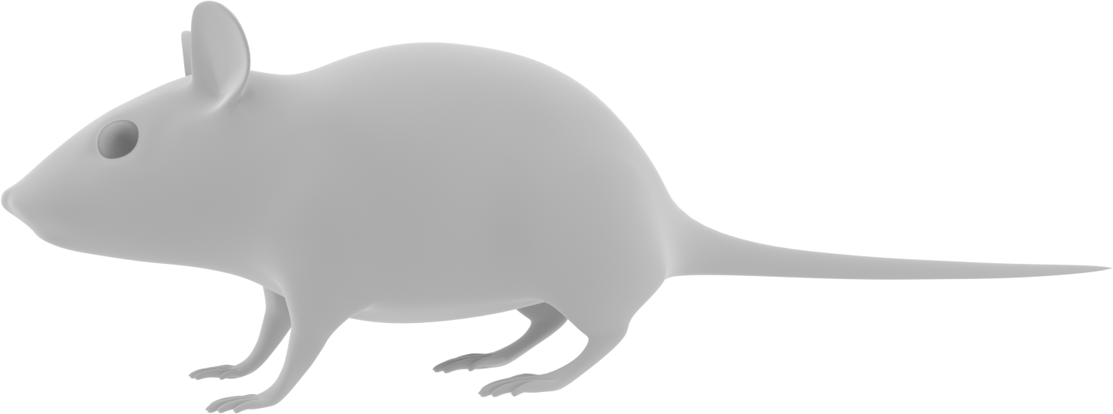
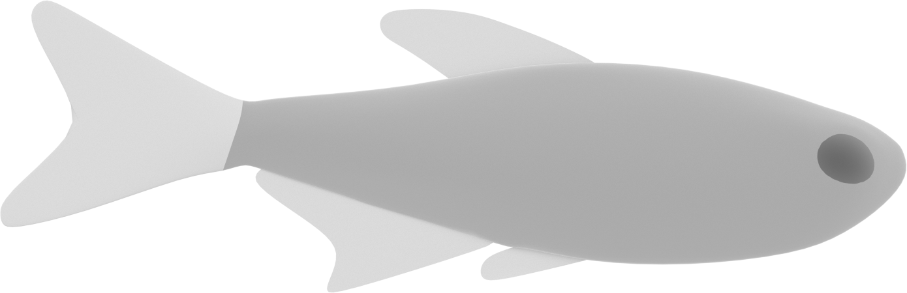
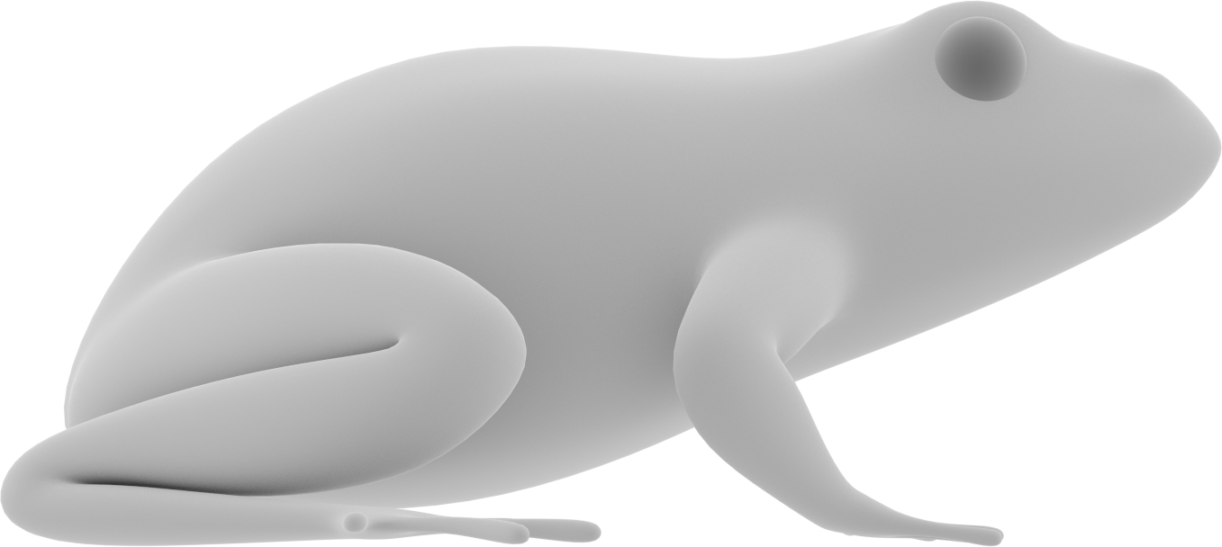
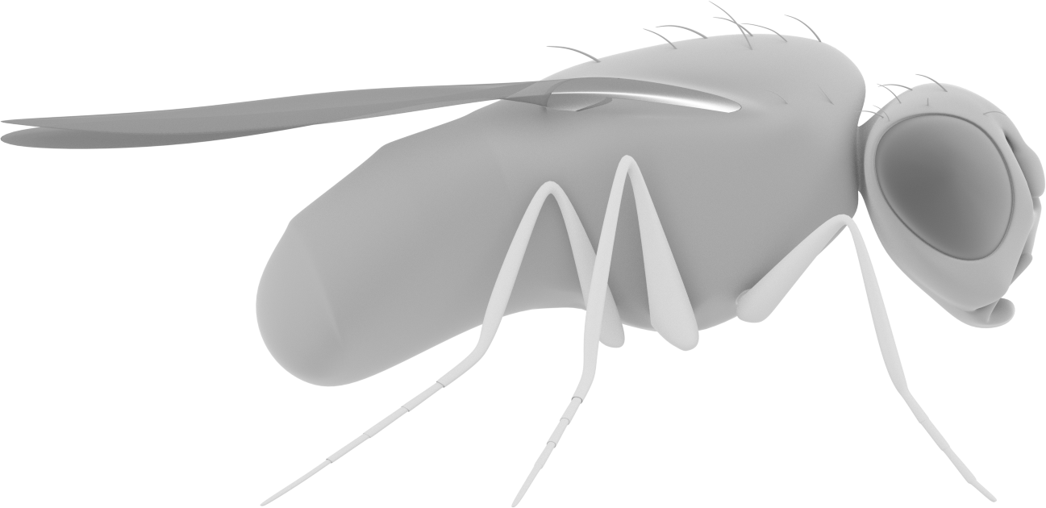

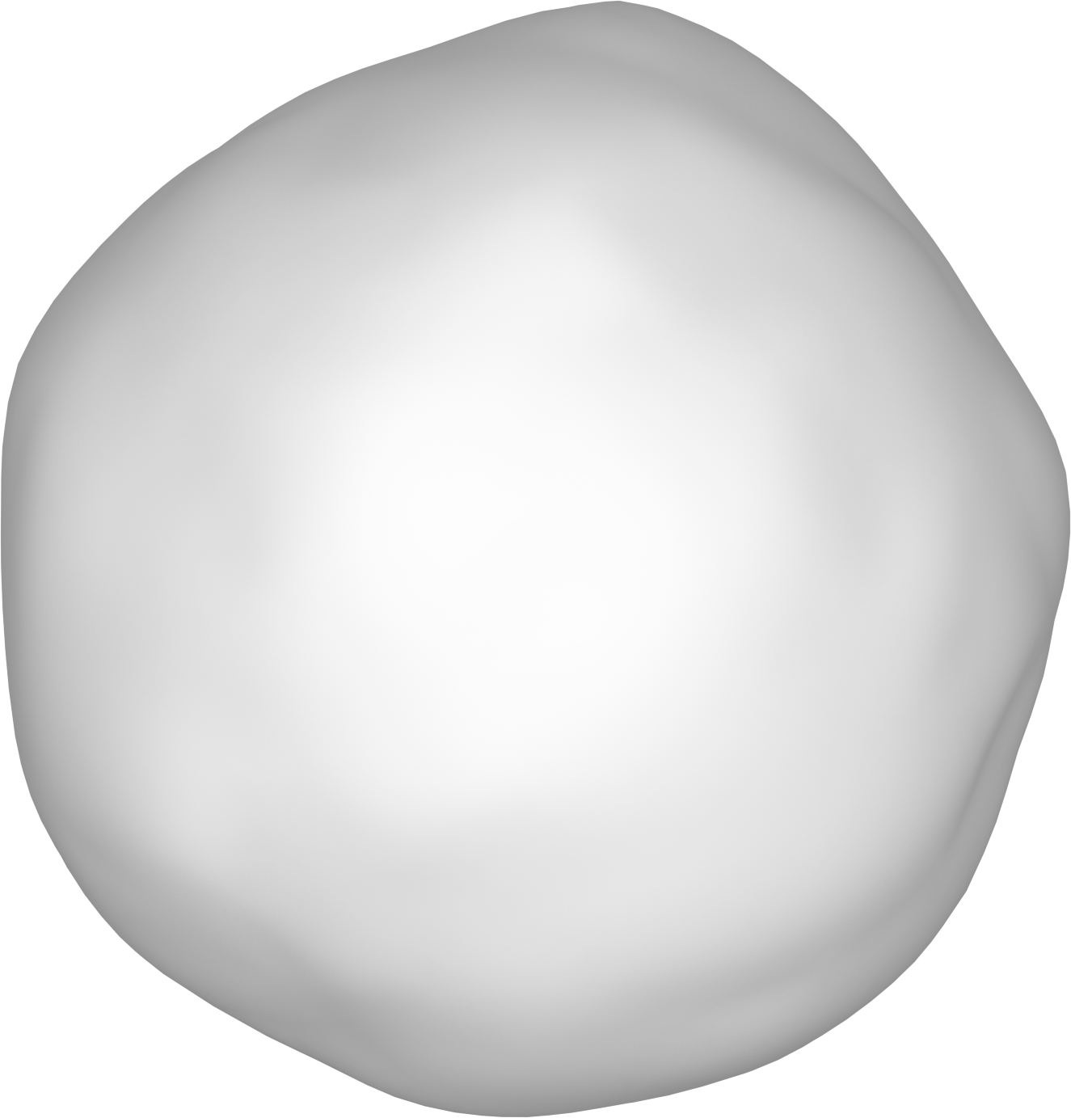
Dietary restriction is a strong and conserved suppressor of aging
Dietary
restriction
Old, ad libitum-fed
rhesus monkey
(27 years)
Old, diet-restricted
rhesus monkey
(27 years)
Colman et al., Science 2009

Slide 10
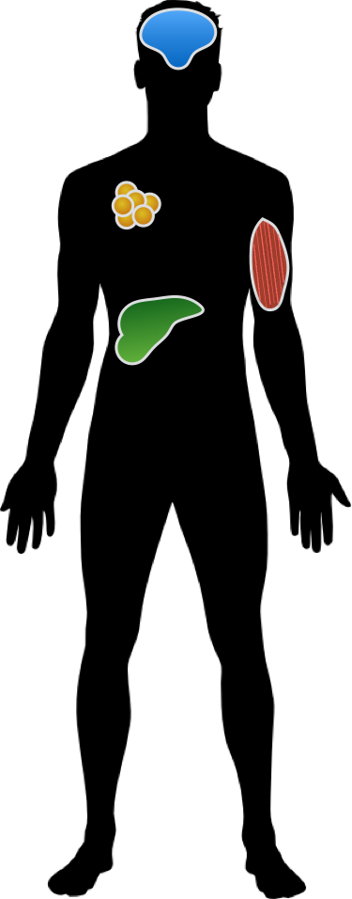

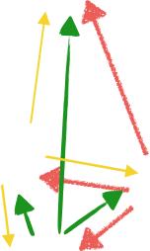

How does dietary restriction slow aging at the tissue and cellular level?

Slide 11
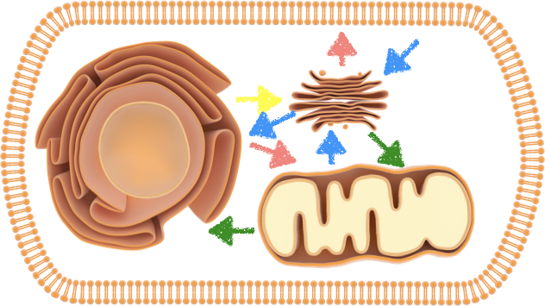
How does dietary restriction slow aging at the tissue and cellular level?

Slide 12
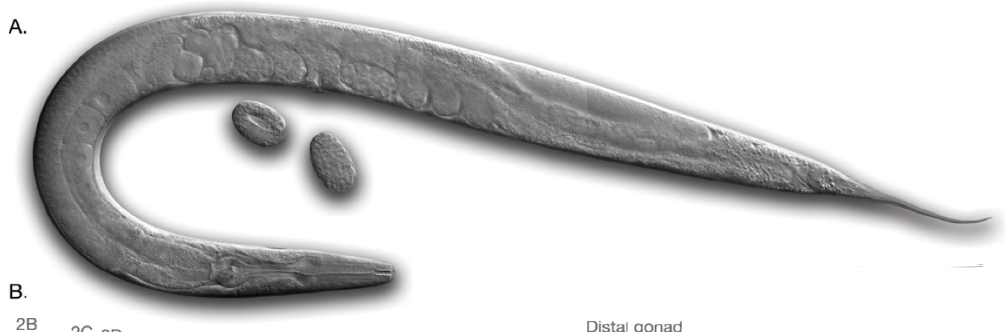
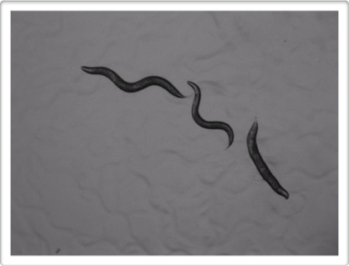
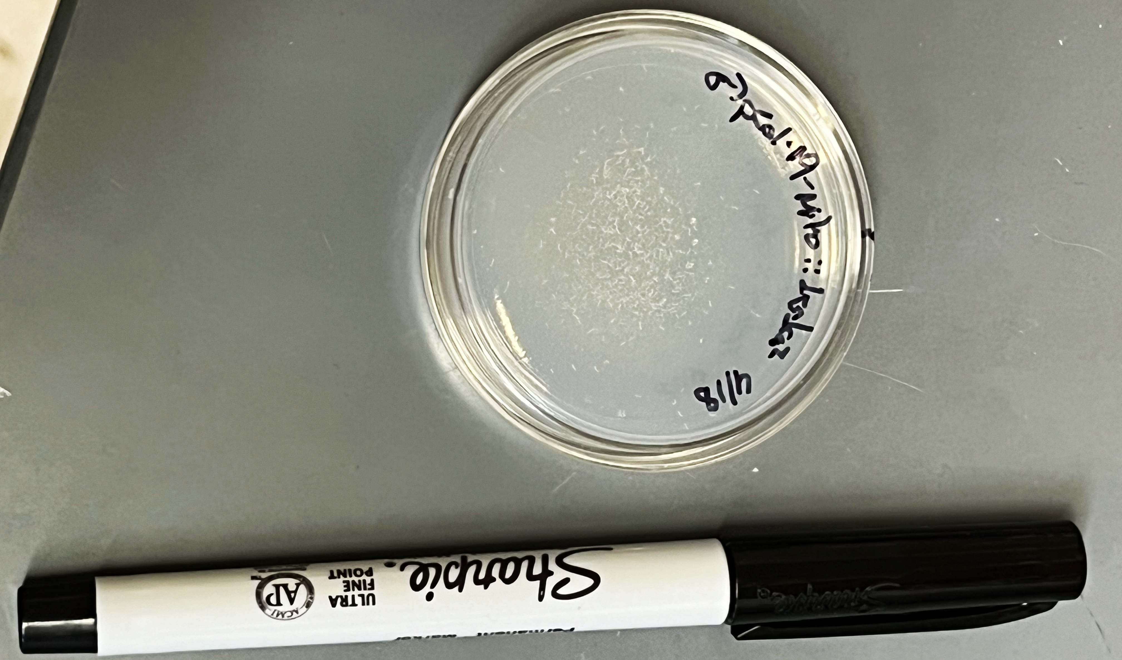
We use C. elegans to understand cellular mechanisms of aging
Similar genes as humans
Rapid development (egg to adult in 3 days)
Short lifespan (~3 weeks)
Wealth of genetic and biochemical tools
Approximately 1 mm in length
“Middle-aged”
8 days old
“Young”
3 days old
100s of worms on one small plate!
“Elderly”
12 days old

Slide 13
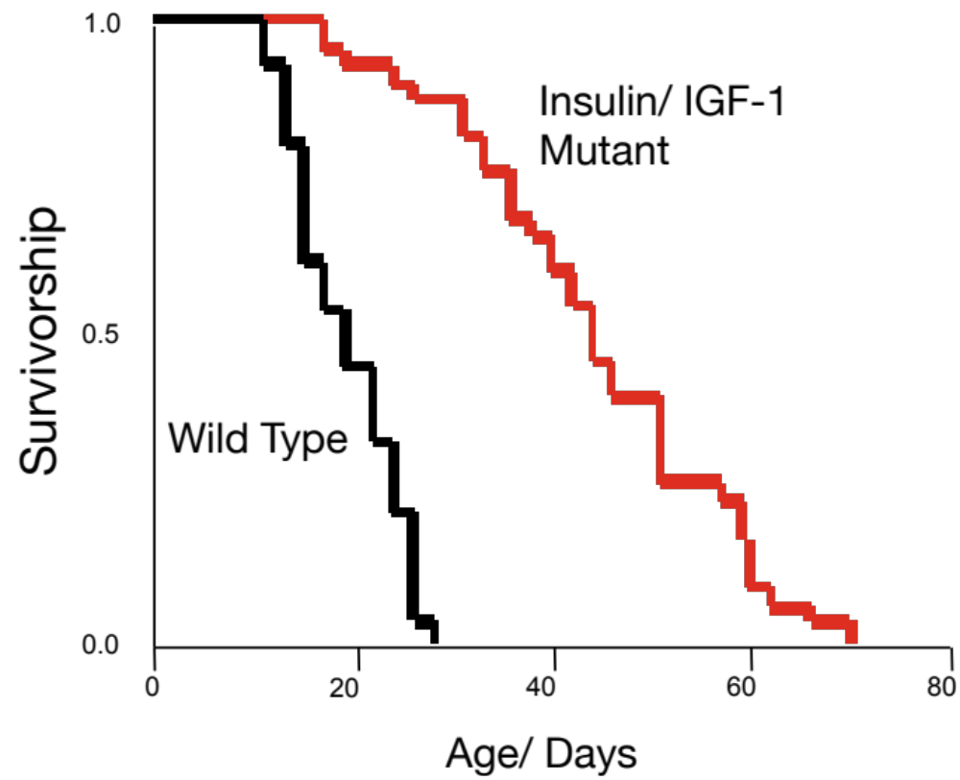
The short lifespan of C. elegans permits rapid lifespan analyses
“Low” energy state, mimics DR
insulin mutant
Conserved in flies and mice
Survivorship
Wild type
Kenyon et al., 1993. Nature
Age
The birth of the genetics of aging field

Slide 14
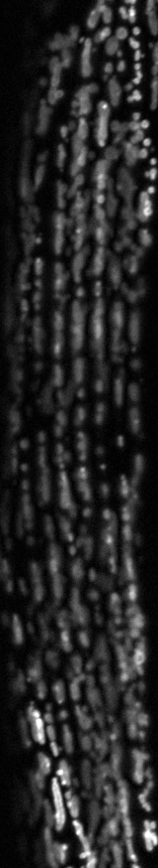
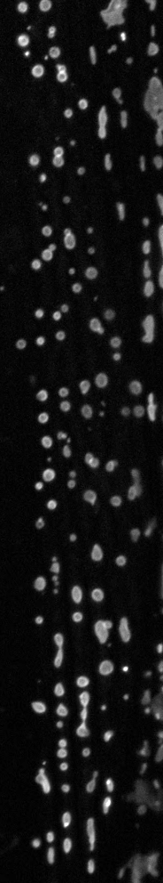


How do anti-aging interventions influence organelle behavior?
Aging-related changes
Age-related disease
Young mitochondria
Aged mitochondria

Slide 15

The simple, yet analogous anatomy of C. elegans allows us to probe tissue-specific aging mechanisms
Transparent
anatomy
Nervous system
body wall muscle
Gut
(liver/adipose)
Reproductive tissues
Hypodermis

Slide 16
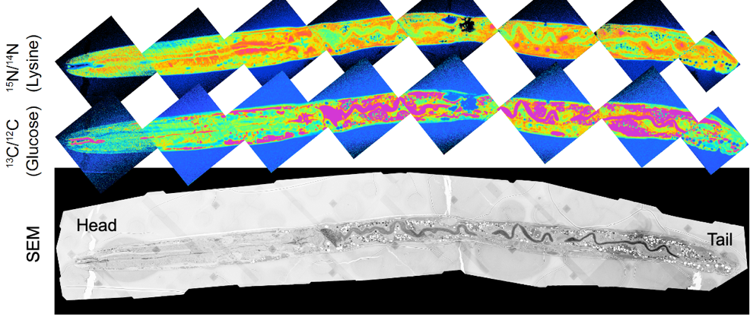
The small size of C. elegans allows us to track the flow and turnover of nutrients
Protein
Sugar

Slide 17
How do organelle interactions change with age and disease?
Alzheimer’s
Parkinson’s
ALS
assorted neuropathies
Nucleus
Golgi
Cancer
Obesity
Diabetes
Endoplasmic
Reticulum
Mitochondrion

Slide 18
What did we learn?
Aging is a leading risk factor for many diseases and is conserved across species
  It may be possible to treat multiple diseases at once by slowing the aging process
C. elegans is a powerful model system to study the genetics and cell biology of aging
There is still much to learn!

Slide 19
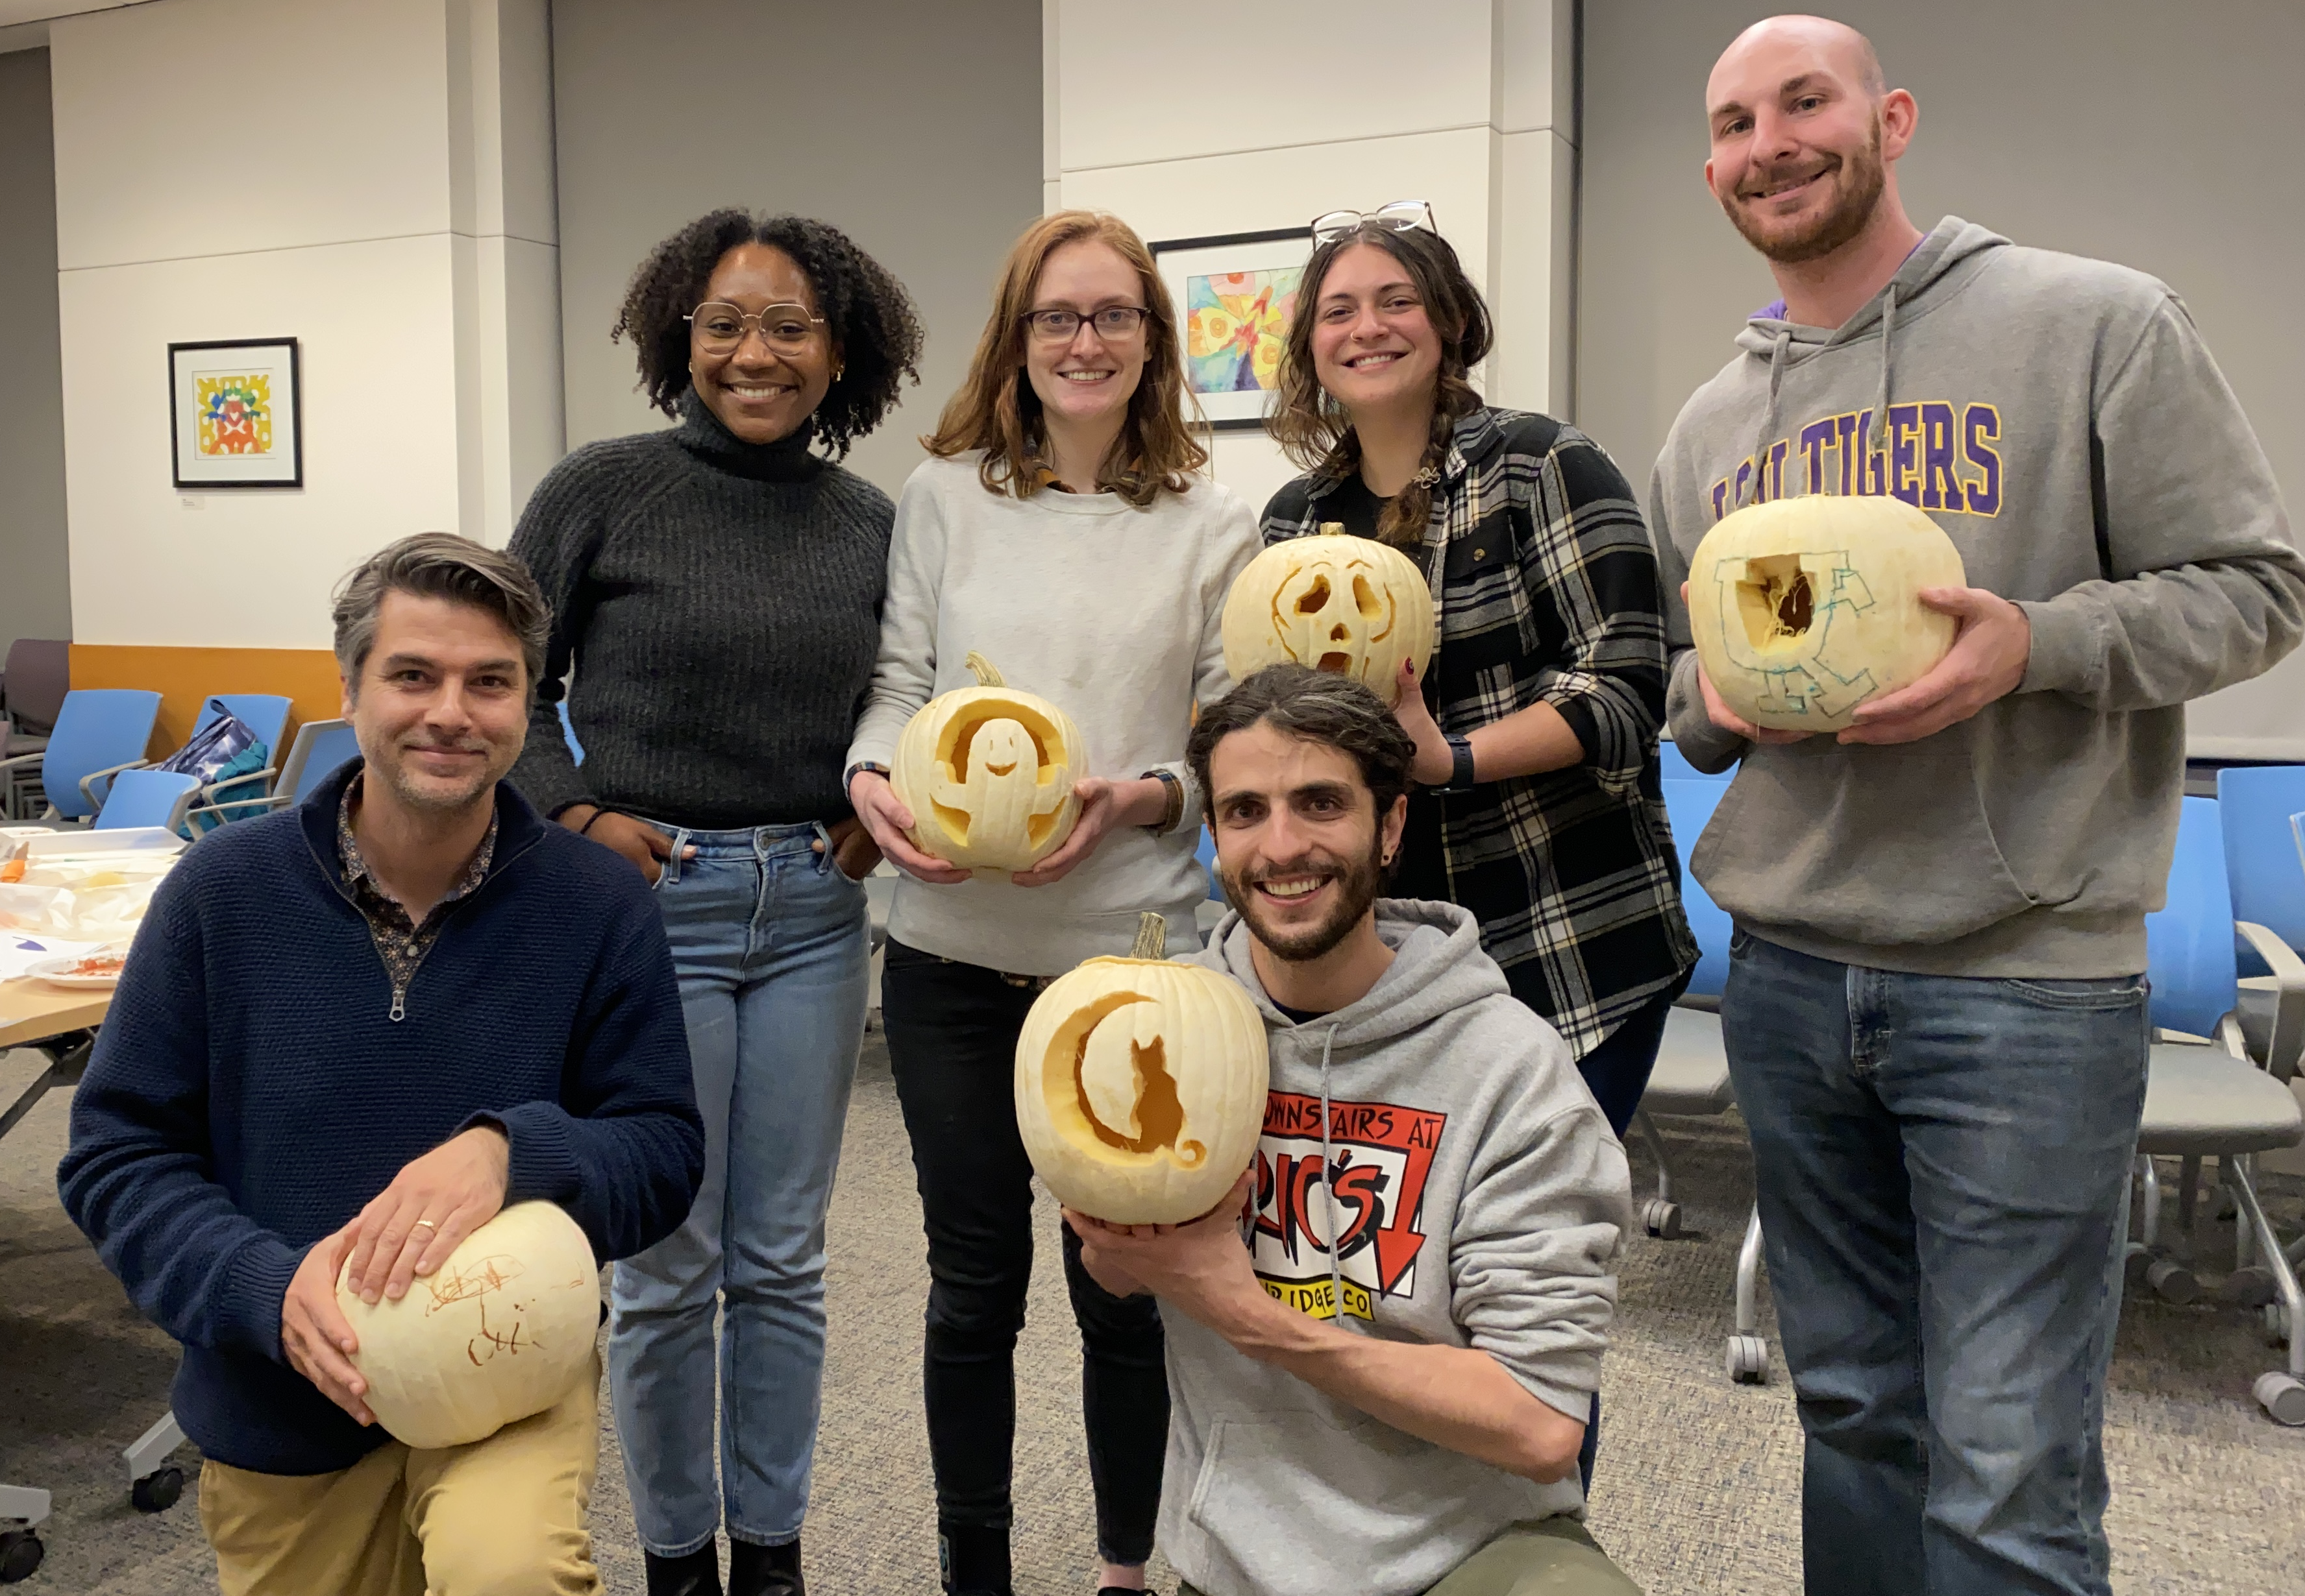
Thank you!
Current lab members
Dr. Kris Burkewitz
Eric Donahue
Elizabeth Ruark
Brianne Jacquet-Cribe
Past lab members
Dr. Gaomin Feng
Alex Mulligan
Caenorhabditis Genetics
Center
Vanderbilt
Rafael Arrojo y Drigo
Vivian Gama
CISR
Evan Krystofiak
Jenny Schafer
Funding
Wash U Center for Cellular Imaging
Greg Strout
John Wulf

Slide 20
Some tips for moving forward from someone that’s been there done that
If you want to get into scientific research…
  Identify broad scientific topics (biology, chemistry, physics) that interest you and research college curriculums that are strong in those areas
  Once you get to college (or potentially while still in high school), get involved in a research lab
    Best way to find out whether or not this is something you actually want to do
  Most of All: ENJOY THE PURSUIT!
    This goes for all things in life, but especially science

