Slide 1
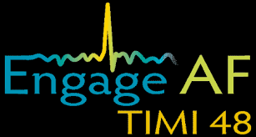
Efficacy and safety of edoxaban vs. warfarin in combination with aspirin in atrial fibrillation patients: Analysis from the ENGAGE AF-TIMI 48 trial
Tyler Butsch, PhD

Slide 2
Management of atrial fibrillation (AF)
Nonvalvular AF is a common heart arrythmia that increases stroke or systemic embolic event (stroke/SEE) risk
Warfarin is commonly prescribed to reduce risk of stroke/SEE
However, warfarin has downsides…
Increased bleeding risk
Slow acting
High variability in effects

Slide 3
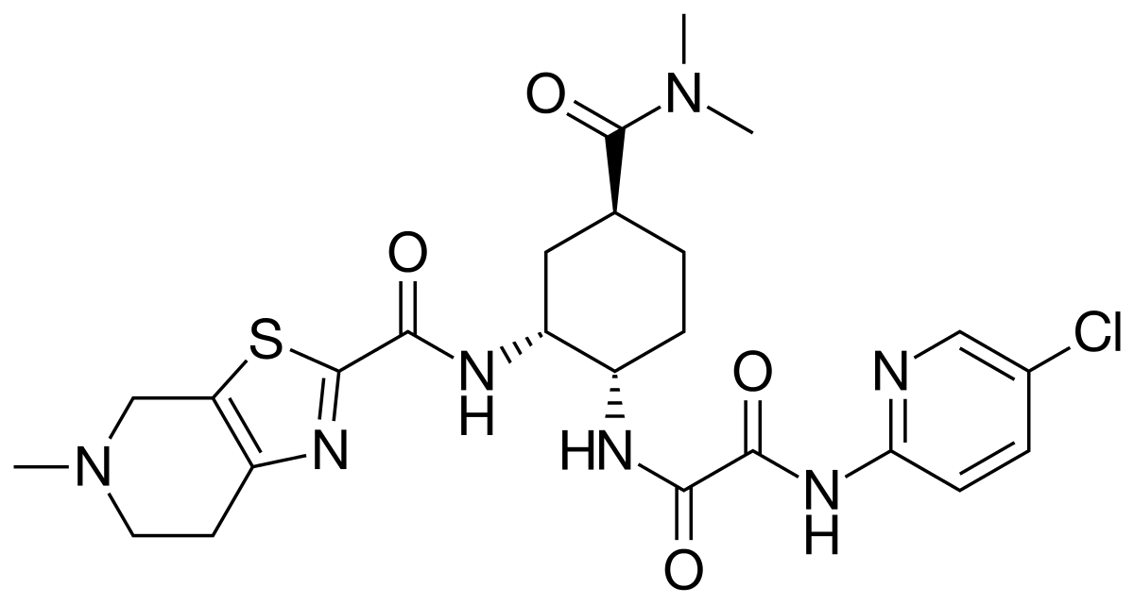

Edoxaban is a promising potential alternative
Direct factor Xa (FXa) inhibitor
FXa
prothrombin
Once daily
Oral administration
t_{1/2} = 10-14 h
Fast acting (1-2 h to peak)
prothrombin
Edoxaban

Slide 4
ENGAGE AF-TIMI 48 trial
Goal: compare efficacy and safety of edoxaban vs. warfarin in AF patients
30 mg edoxaban
60 mg edoxaban
warfarin
1° Efficacy: stroke/SEE
1° Safety: major bleeding (per ISTH guidelines)
1° Efficacy: edoxaban was noninferior
1° Safety: edoxaban reduced major bleeding risk

Slide 5
CAD and other comorbidities are common in AF patients
Many AF patients are elderly and the incidence of coronary arterial disease (CAD) is 34%¹.
CAD is typically treated with antiplatelet agents, such as aspirin.
Anticoagulant (warfarin or edoxaban)
+
Antiplatelet agent (aspirin)
Major bleeding
1: Kralev et al., 2011. Plos One

Slide 6
A significant fraction of patients in the ENGAGE AF-TIMI 48 trial were taking aspirin
Landmark period | Total, n/N (%) | Warfarin, n/N (%) | Edoxaban, n/N (%)
Baseline | 4161/14068 (29.6%) | 2092/7034 (29.7%) | 2070/7034 (29.4%)
3 months | 3036/13326 (22.9%) | 1514/6641 (22.8%) | 1522/6595 (23.1%)
6 months | 2853/12793 (22.3%) | 1422/6423 (22.1%) | 1431/6370 (22.5%)
12 months | 2794/12493 (22.4%) | 1412/6250 (22.6%) | 1382/6243 (22.1%)
18 months | 2813/12268 (22.9%) | 1399/6147 (22.8%) | 1414/6121 (23.1%)
24 months | 2720/12004 (22.7%) | 1343/6002 (22.3%) | 1377/6002 (22.9%)
30 months | 1981/8786 (22.5%) | 1006/4392 (22.9%) | 975/4394 (22.2%)

Slide 7
Study design
Goal: compare efficacy and safety of edoxaban vs. warfarin in combination with aspirin in AF patients
No aspirin
Aspirin
60 mg edoxaban
warfarin
60 mg edoxaban
warfarin
1° Efficacy: stroke/SEE
1° Safety: major bleeding (per ISTH guidelines)

Slide 8
Edoxaban and warfarin exhibit similar efficacy when combined with aspirin
1° Efficacy

Slide 9
Edoxaban causes fewer bleeding events than warfarin in combination with aspirin
1°Safety
1° Clinical

Slide 10
Conclusions
Edoxaban and warfarin are similarly effective at preventing stroke/SEE with or without aspirin
Edoxaban reduces major bleeding risk compared to warfarin with or without aspirin
Edoxaban may be a safer alternative to warfarin for patients also taking aspirin

